Slide 1
Detection and segmentation of robot hands and objects selected for picking
MSc Artificial Intelligence
Muraleekrishna Harikumar Sreeja

Slide 2
OBJECTIVE
By performing instance segmentation at the pixel level, I attempt to do automated object detection to recognize both robot hand and the objects they are assigned to pick , marking them with bounding boxes, class labels, and masks.

Slide 3
DATASET
The CRISP (Cognitive Robotics and Intelligent Systems for the People) Teleoperated Fruit Picking Dataset – RoboPuppetteer
Original dataset - Videos/images (RGB-D sensor, Kinect v2), the motion of the robot, the motion of the human hand controlling the robot, and tactile feedback from the robot’s fingertips.
Objects -> Grocery items – avocado, banana, and blueberry ~ single and cluttered.
Chosen 420 pictures at random from both the cluttered and the individual images of these grocery items.
300 images for training
120 images for testing.

Slide 4
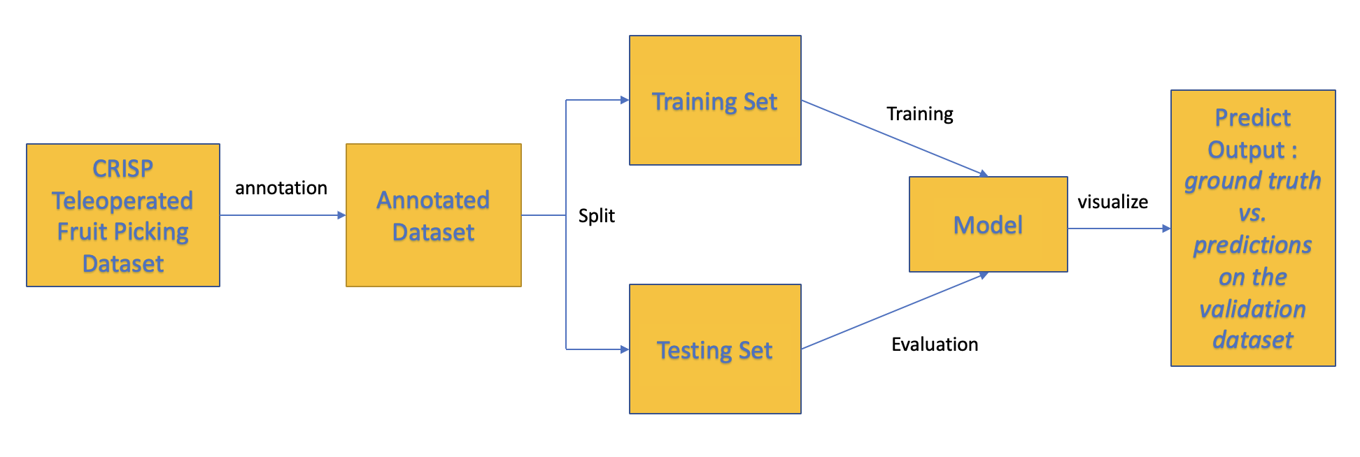
PROPOSED MODEL WORKFLOW

Slide 5
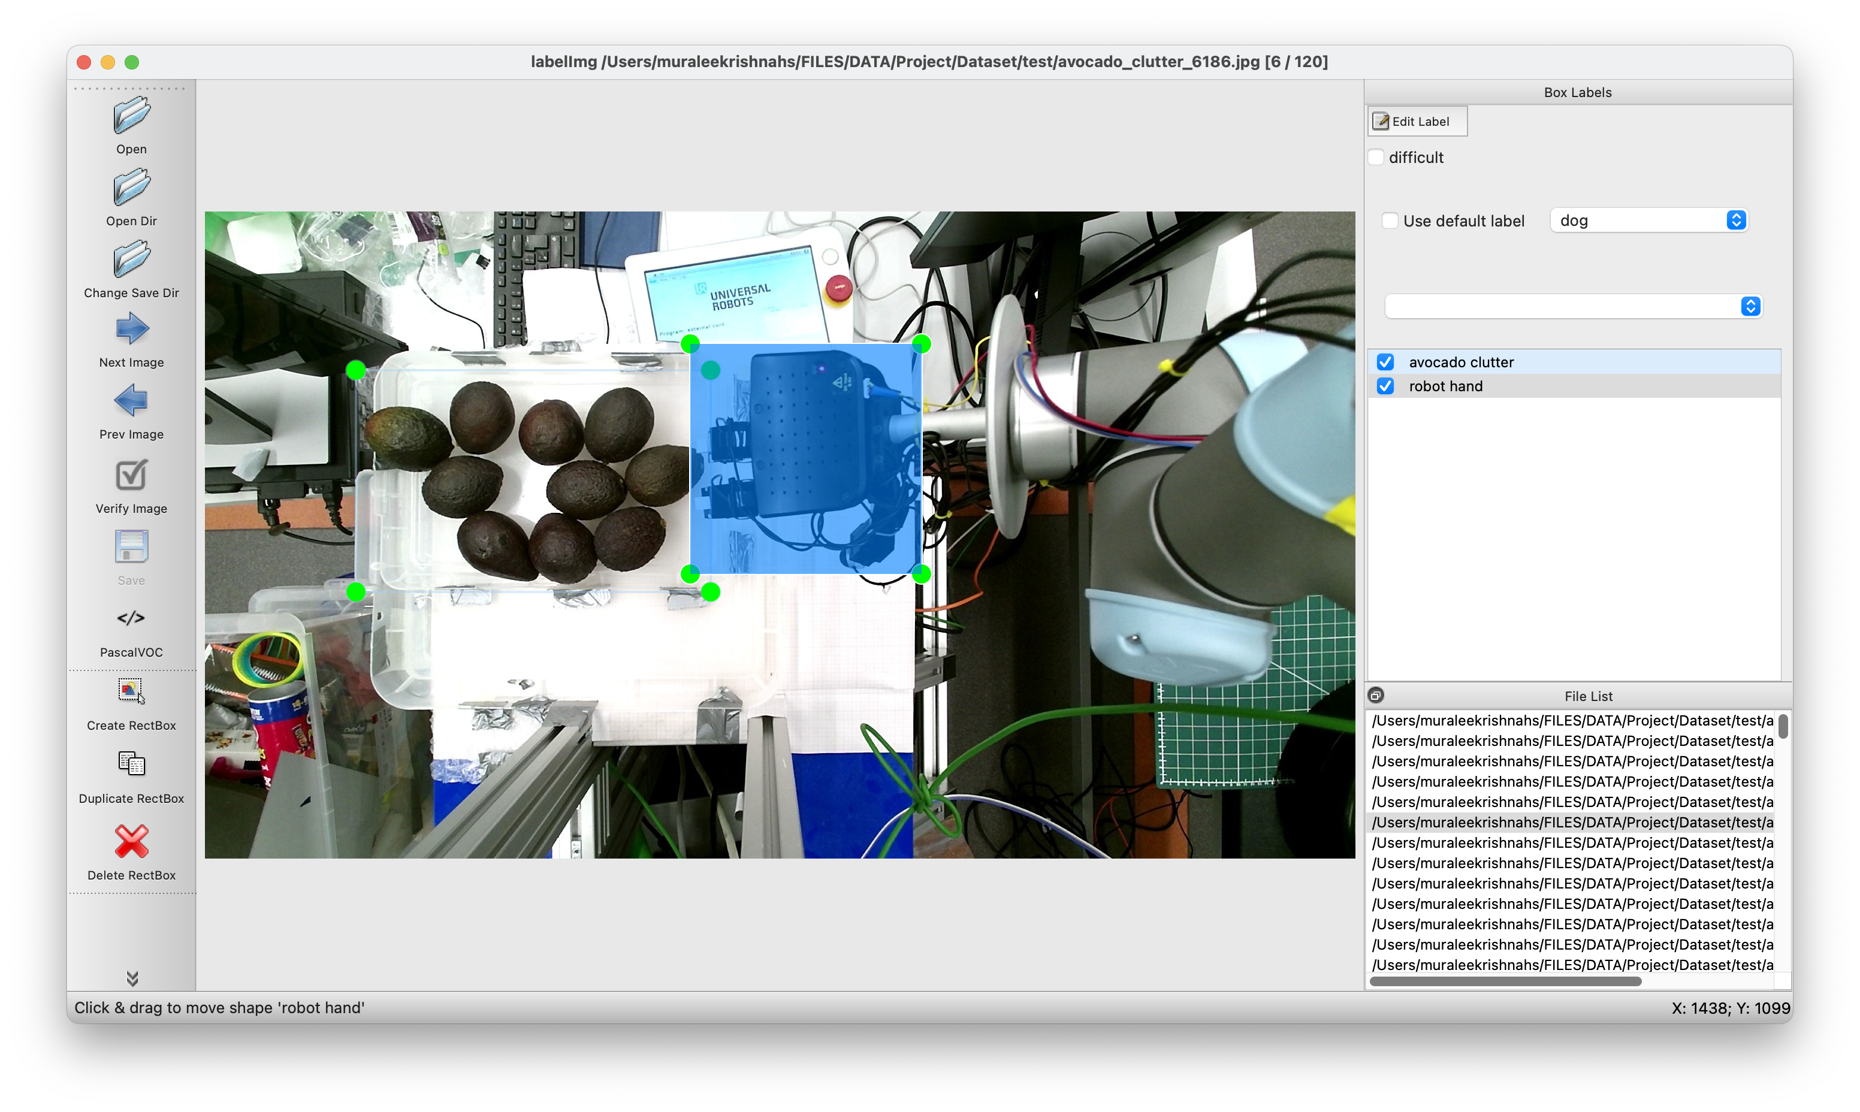
IMAGE ANNOTATION
LabelImg - Python-based tool - graphical image annotation
The PASCAL VOC format - .xml files.

Slide 6
MODEL

Slide 7
MASK R-CNN
Convolutional Neural Network (CNN)
Object detection – Instance Segmentation
Extension of Faster R-CNN
object mask in parallel with the existing branch for bounding box recognition.

Slide 8
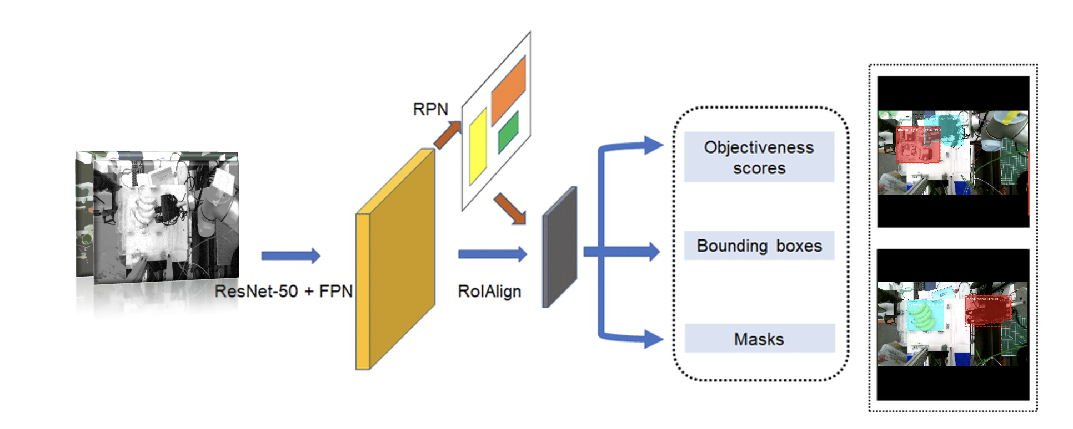
MASK R-CNN ARCHITECTURE

Slide 9
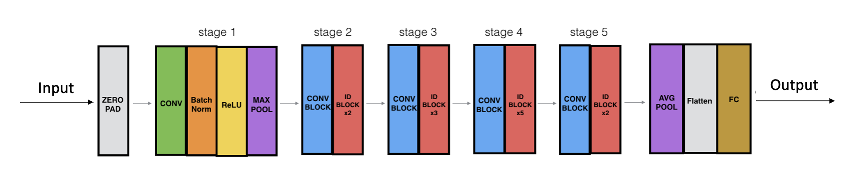
RESNET50 ARCHITECTURE
ResNet50 - ResNet model - 48 Convolution layers - 1 MaxPool - 1 Average Pool layer.

Slide 10
IMPLEMENTATION

Slide 11
TRAINING
10 epochs ( 2 heads + 8 all)
47 minutes/epoch (approx.) ~ 8 hours total
Heads – 0.002 , All layer – 0.001
Transfer learning – ”COCO” dataset

Slide 12
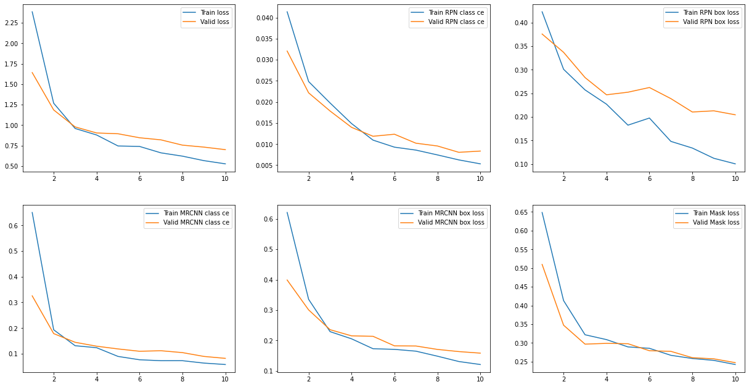
TRAINING HISTORY

Slide 13
OUTPUT

Slide 14
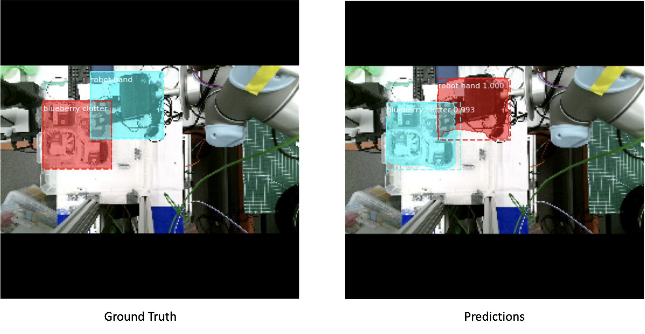

Slide 15
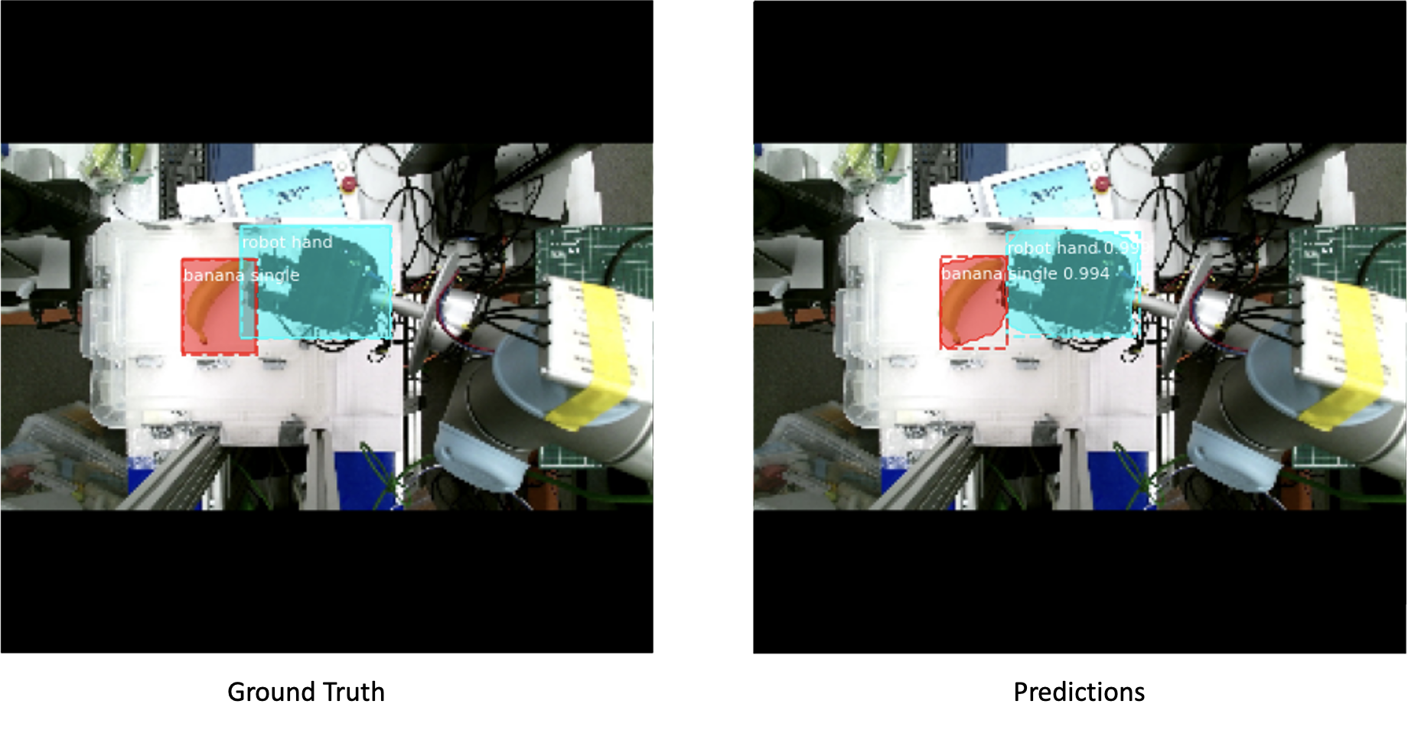

Slide 16
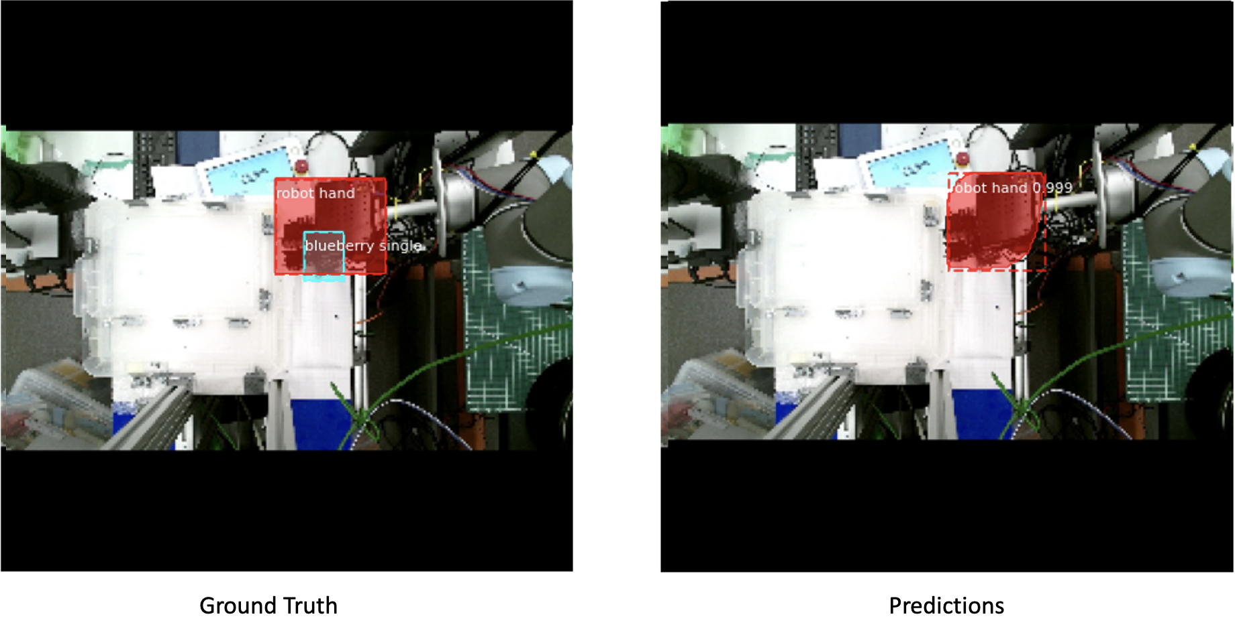

Slide 17
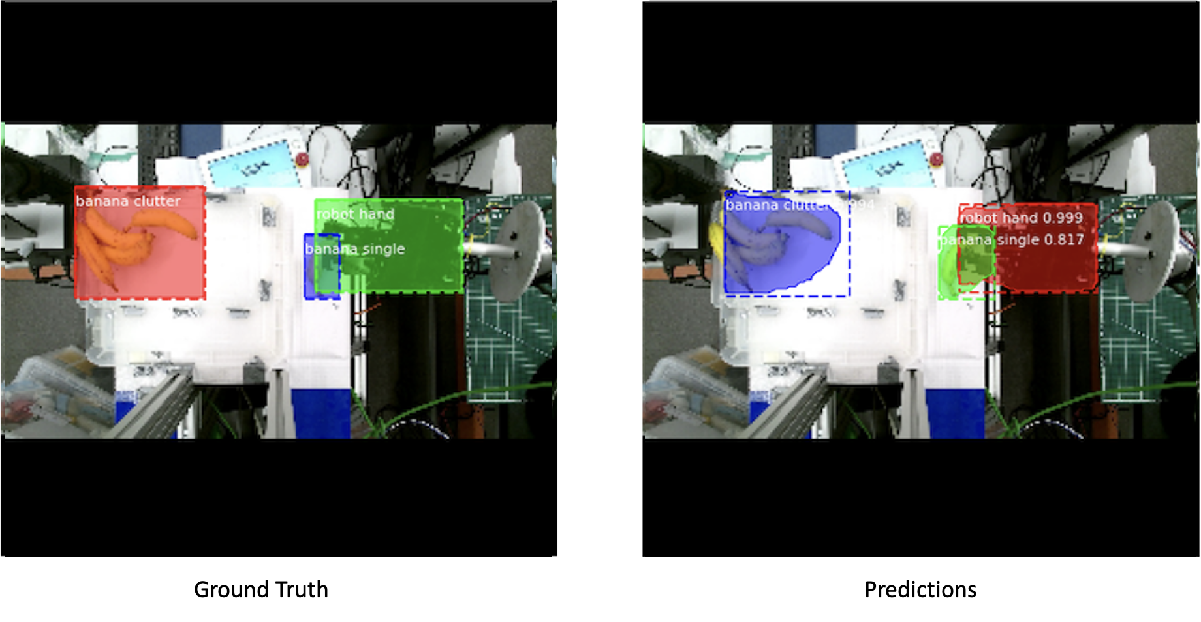

Slide 18
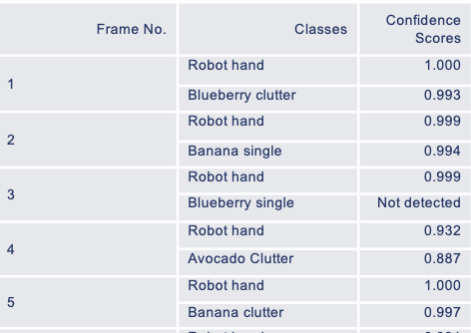
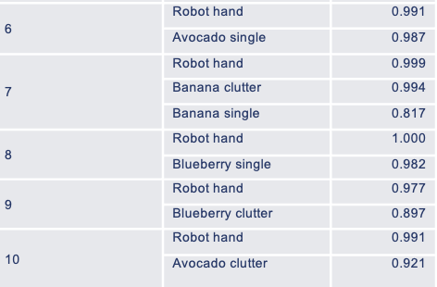
CONFIDENCE SCORE OF DETECTED CLASSES

